Slide 1
An Iterative BP-CNN Architecture for Channel Decoding under Additive Colored Gaussian noise
GiGi Chou
Advisor: Prof. Jiun Hung Yu
Prof. Tofar Chih-Yuan Chang
Transmission and Networking Technologies Laboratory,
Institute of Communications Engineering
National Chiao Tung University, Hsinchu, Taiwan
GiGi, Chou
TNT_LAB , NYCU
1
January , 2
Notes:
接收器知道噪聲的相關性函數（例如相關矩陣或自相關函數）。

Slide 2
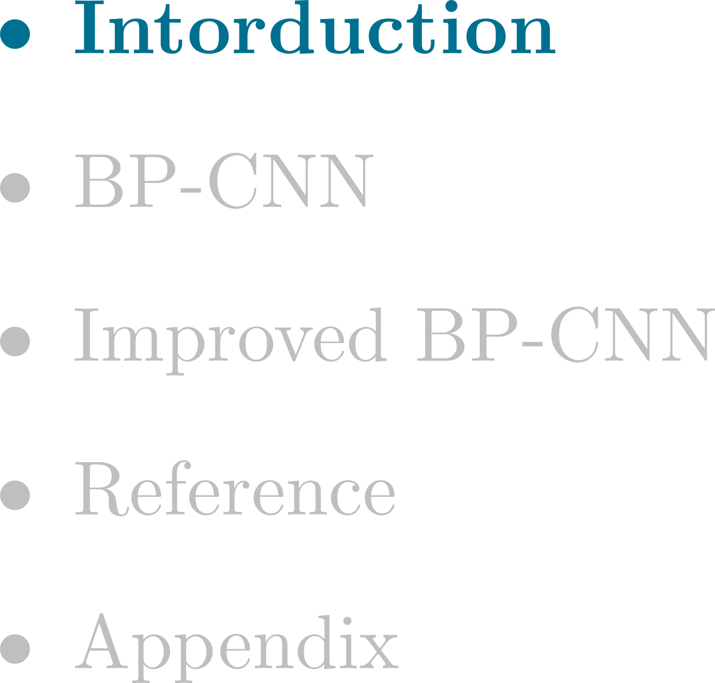
Outline
GiGi, Chou
TNT_LAB , NYCU
2
January , 2

Slide 3
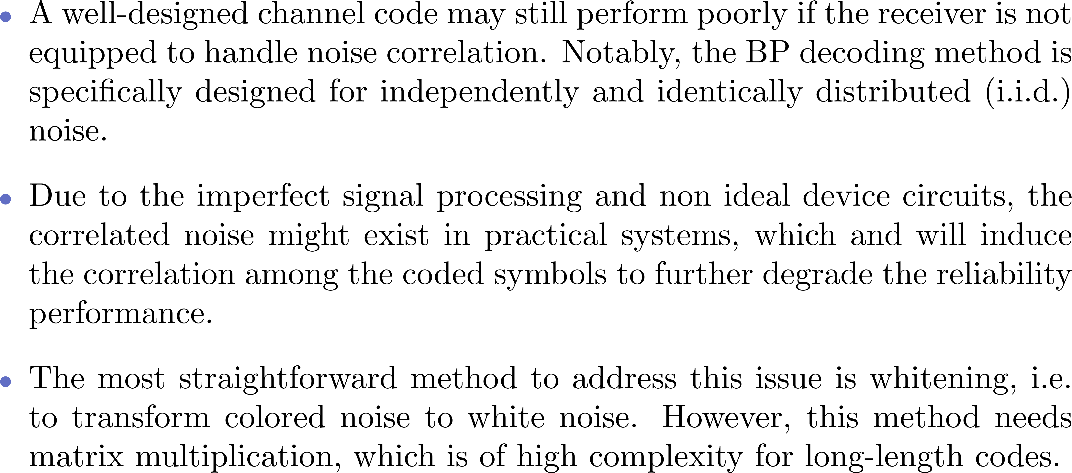
Introduction
GiGi, Chou
TNT_LAB , NYCU
3
January , 2
Notes:
值得注意的是，BP 解碼方法是針對獨立且同分佈 (i.i.d.) 噪聲所設計的。

Slide 4
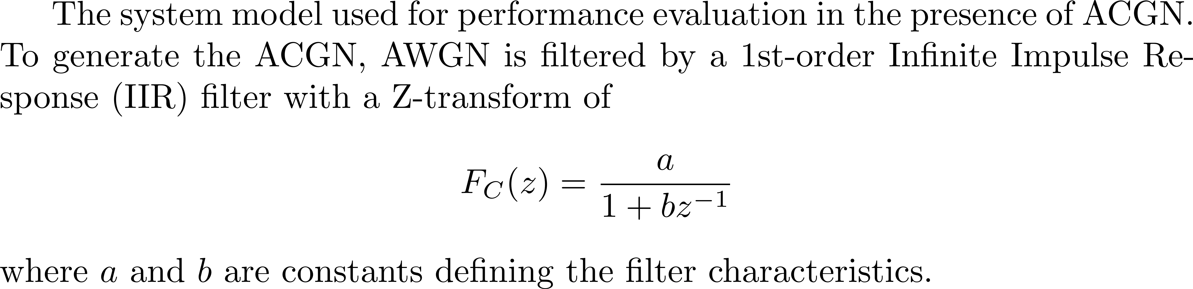
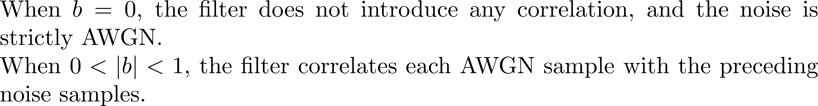
Introduction – Example[1]
GiGi, Chou
TNT_LAB , NYCU
4
January , 2

Slide 5

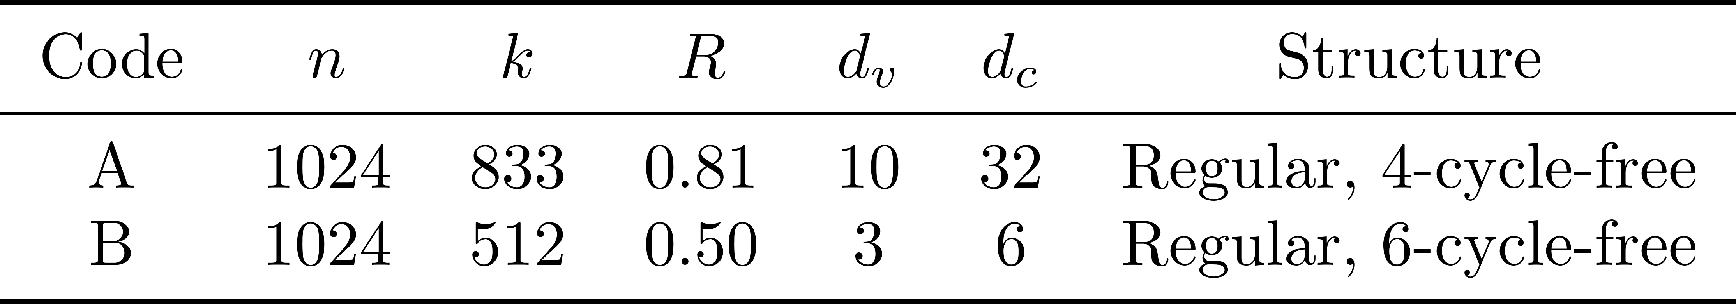
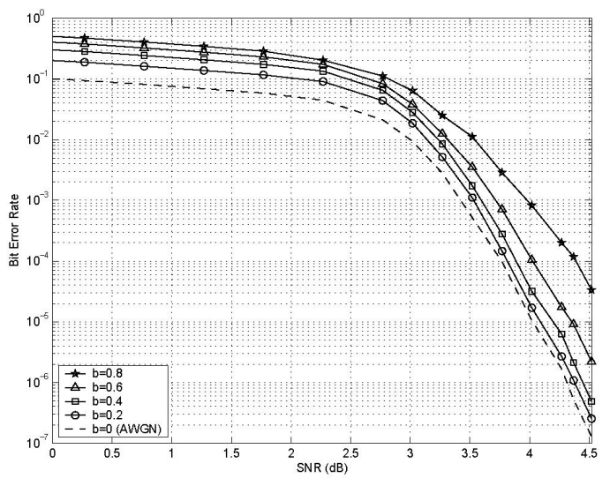
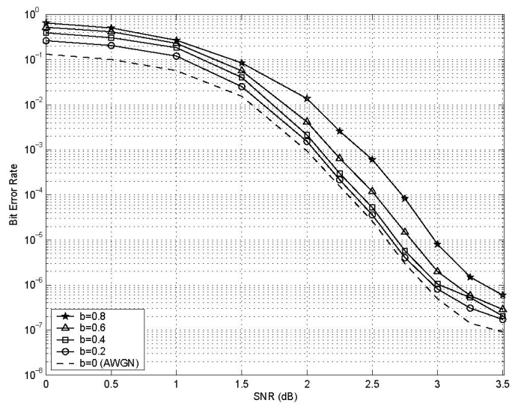


Introduction - Example[1]
GiGi, Chou
TNT_LAB , NYCU
5
January , 2

Slide 6

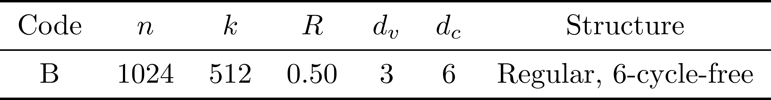
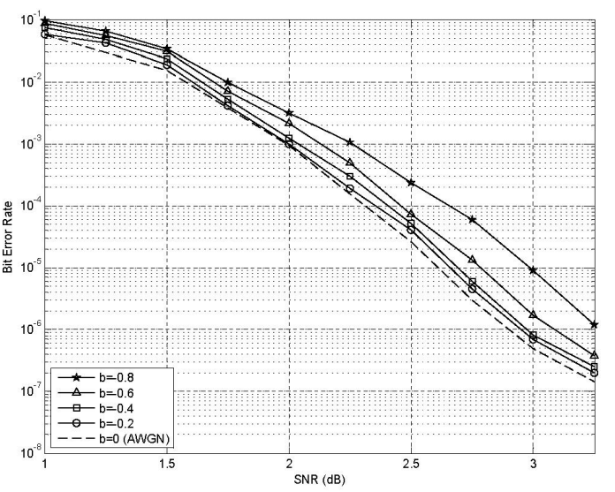
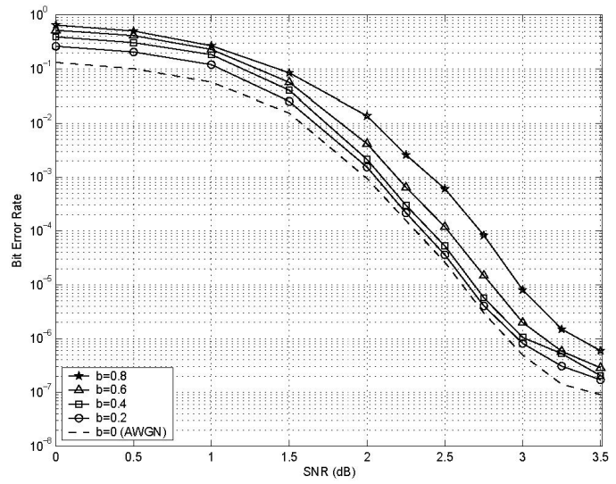


Introduction - Example[1]
GiGi, Chou
TNT_LAB , NYCU
6
January , 2

Slide 7
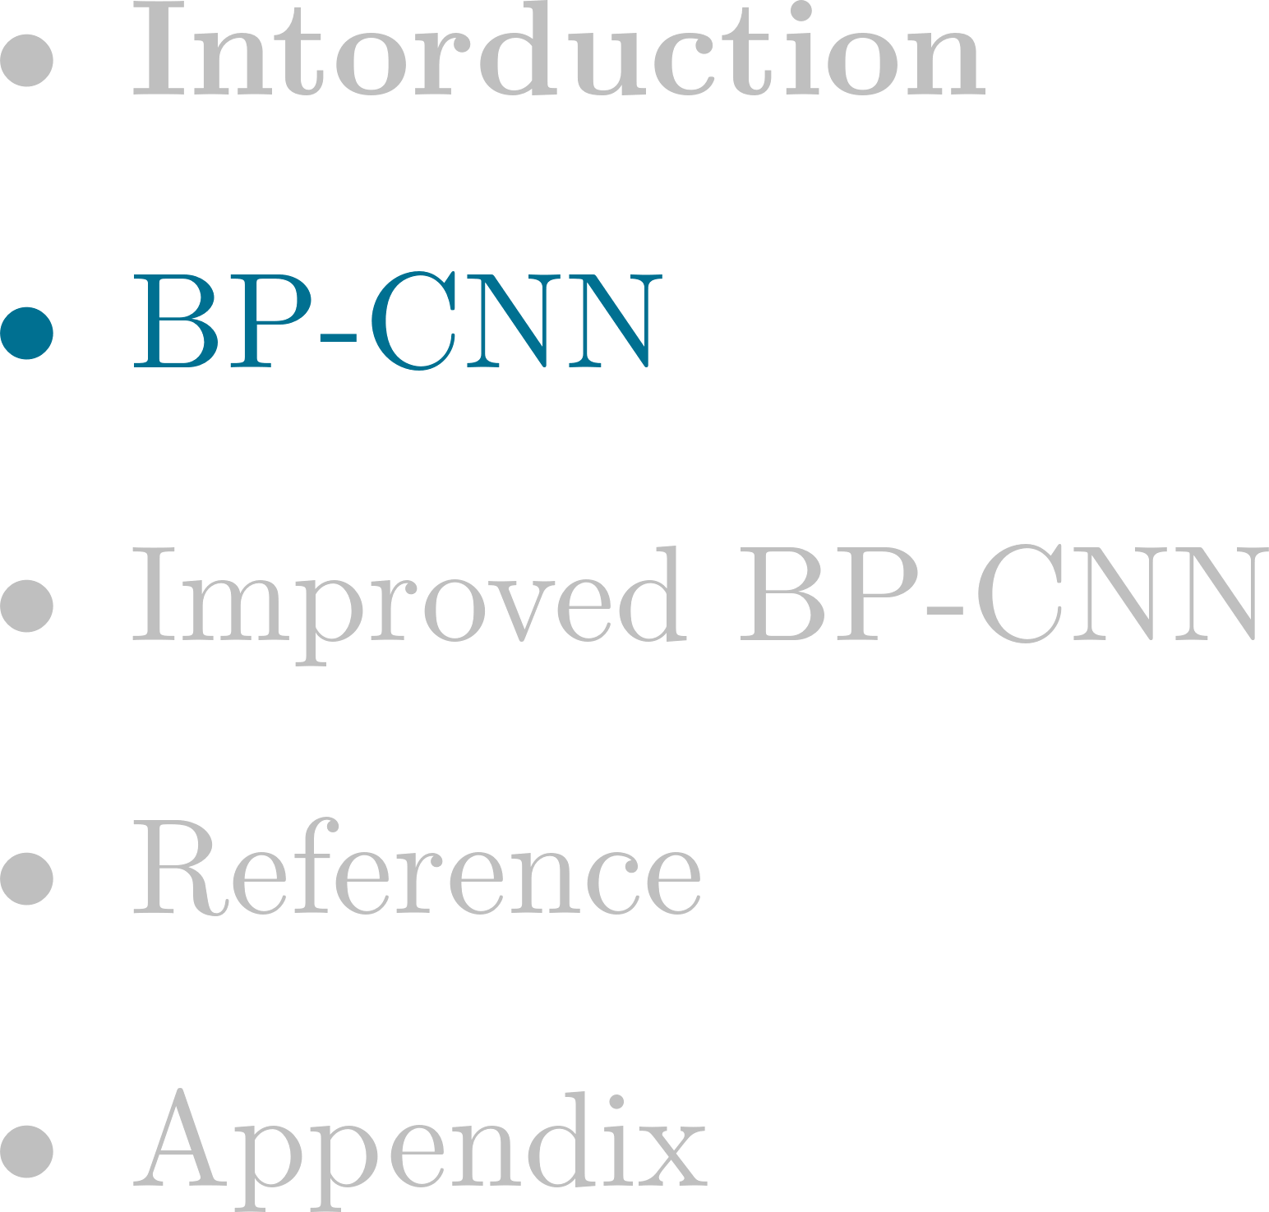
Outline
GiGi, Chou
TNT_LAB , NYCU
7
January , 2

Slide 8
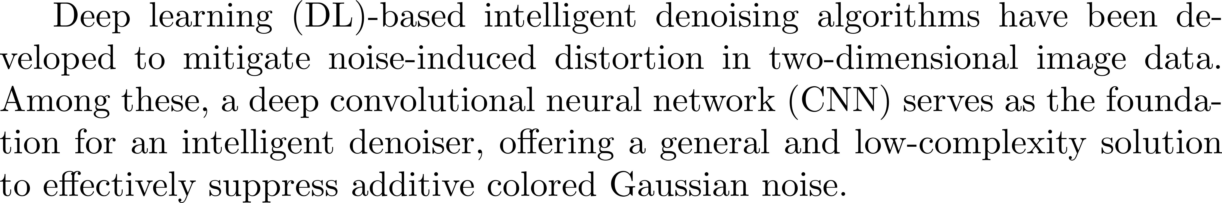

BP-CNN
GiGi, Chou
TNT_LAB , NYCU
8
January , 2
Notes:
CNN 的數學核心是卷積運算，它提取局部特徵，通過非線性激活和池化進一步濃縮信息

Slide 9
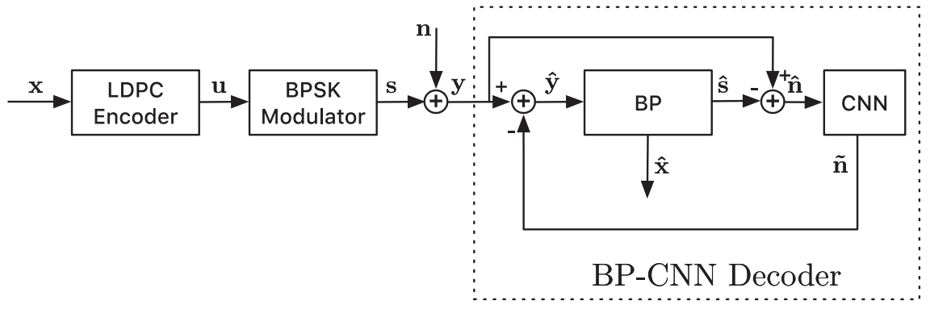
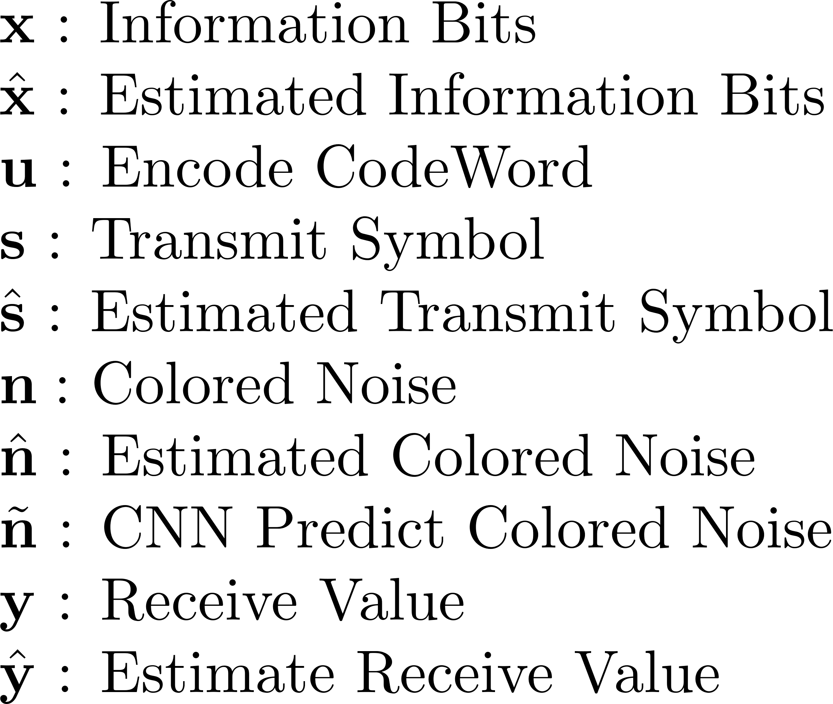
BP-CNN - Structure
GiGi, Chou
TNT_LAB , NYCU
9
January , 2
Notes:
CNN 的數學核心是卷積運算，它提取局部特徵，通過非線性激活和池化進一步濃縮信息。
\xi = ksee

Slide 10
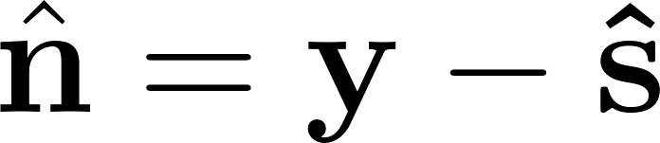


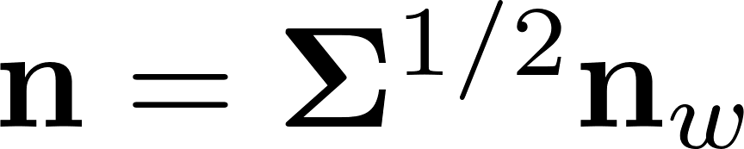
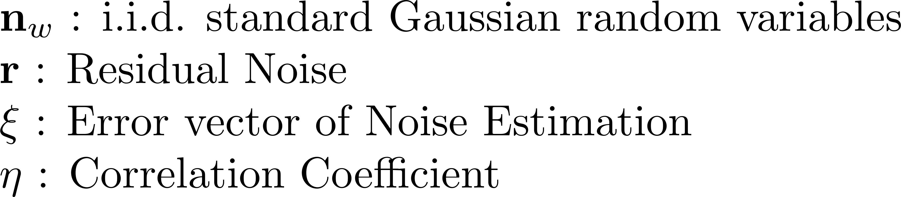

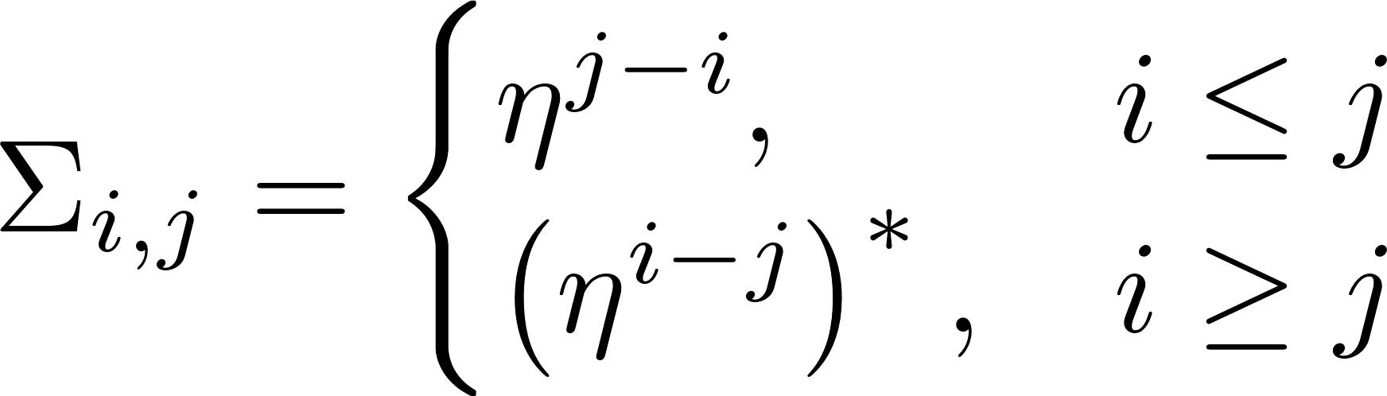
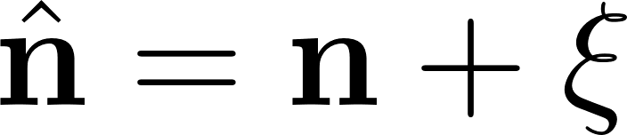
BP-CNN - Structure
3
2
1
1
2
3
GiGi, Chou
TNT_LAB , NYCU
10
January , 2
Notes:
CNN 的數學核心是卷積運算，它提取局部特徵，通過非線性激活和池化進一步濃縮信息。
\xi = ksee

Slide 11









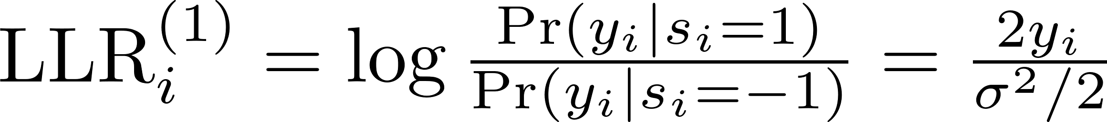
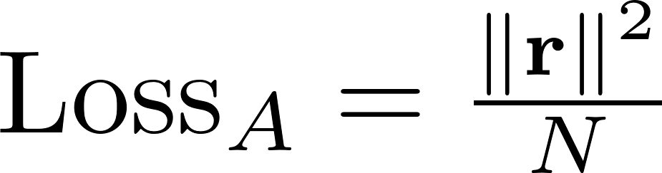
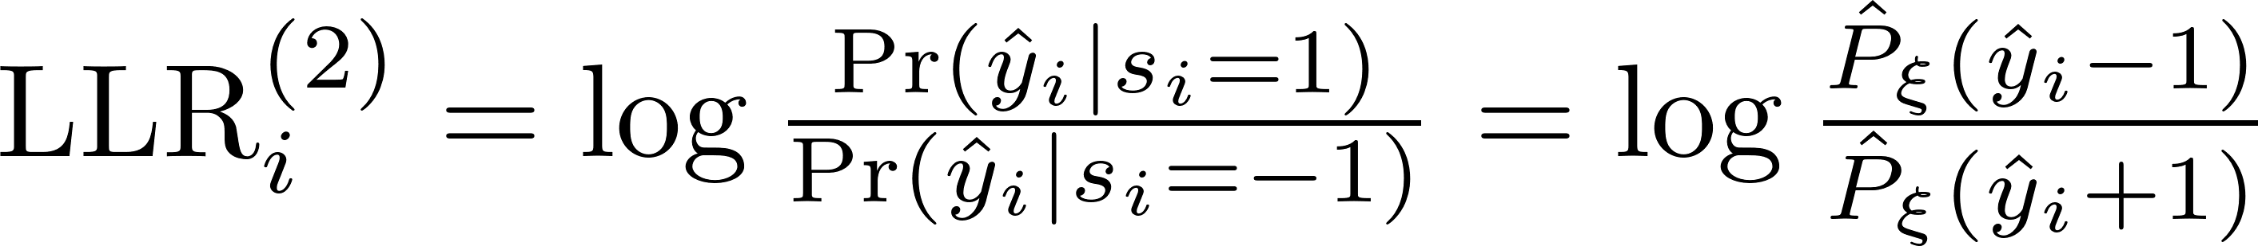


BP-CNN - Baseline BP-CNN
BP
CNN
BP
GiGi, Chou
TNT_LAB , NYCU
11
January , 2
Notes:
Mean square error
（經驗概率分佈）是基於觀察到的數據來估計隨機變量的概率分佈，而是直接使用數據來構建分佈模型。

Slide 12


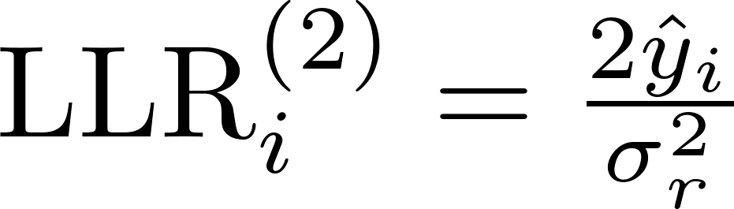


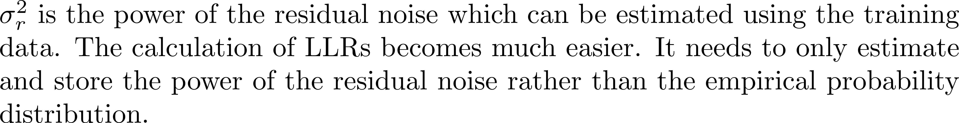

BP-CNN - Enhanced BP-CNN
BP
CNN
BP
GiGi, Chou
TNT_LAB , NYCU
12
January , 2
Notes:
CNN 的數學核心是卷積運算，它提取局部特徵，通過非線性激活和池化進一步濃縮信息。
\xi = ksee
Mean square error
（經驗概率分佈）是基於觀察到的數據來估計隨機變量的概率分佈，而是直接使用數據來構建分佈模型。

Slide 13
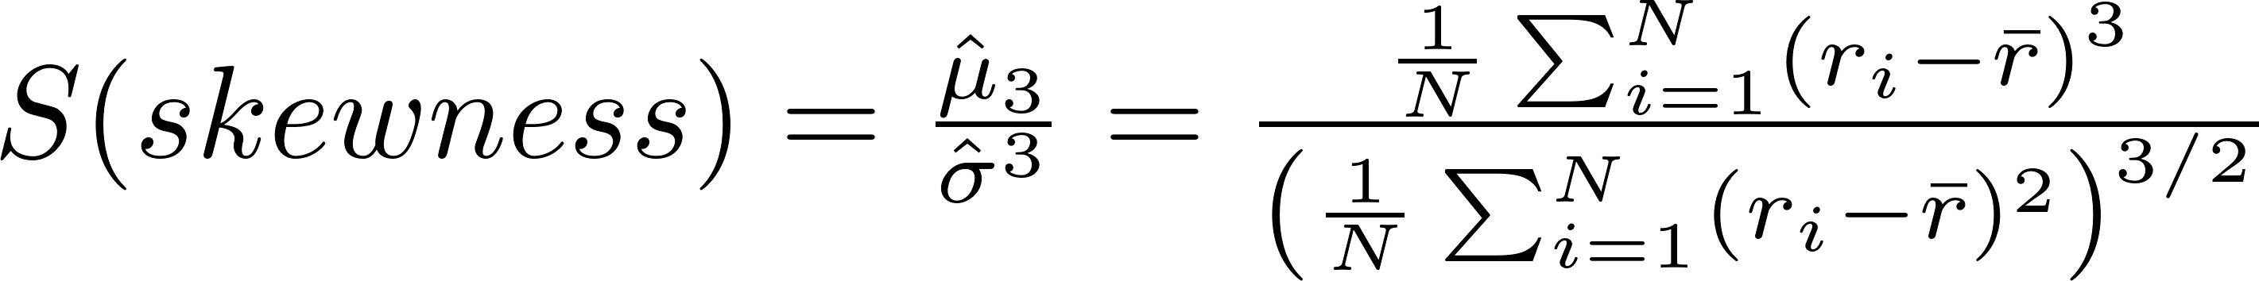
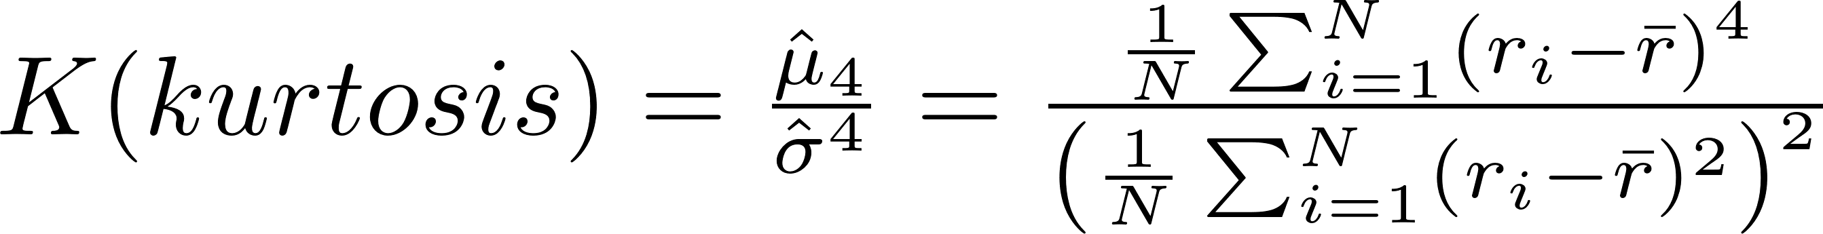
BP-CNN - Enhanced BP-CNN
BP
CNN
BP
GiGi, Chou
TNT_LAB , NYCU
13
January , 2
Notes:
S 是偏度
K是峰度
如果JB檢定的統計量很大，這代表資料偏離正態分佈的程度很大。即數據不符合正態分佈。
如果JB檢定的統計量很小，表示偏態和峰度接近於正態分佈的特徵值（偏態為0，峰度為3）。數據符合正態分佈。

Slide 14
BP-CNN - Simulation
GiGi, Chou
TNT_LAB , NYCU
14
January , 2
Notes:
CNN 的數學核心是卷積運算，它提取局部特徵，通過非線性激活和池化進一步濃縮信息。
\xi = ksee

Slide 15
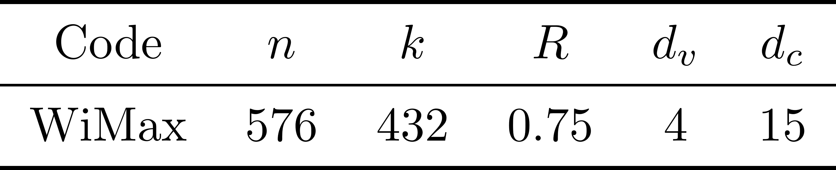

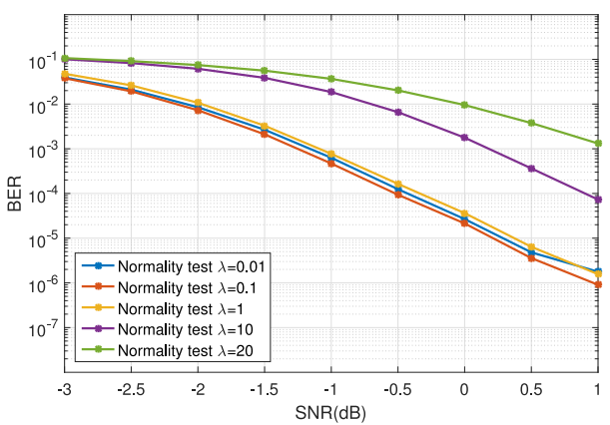


BP-CNN – Simulation
GiGi, Chou
TNT_LAB , NYCU
15
January , 2

Slide 16
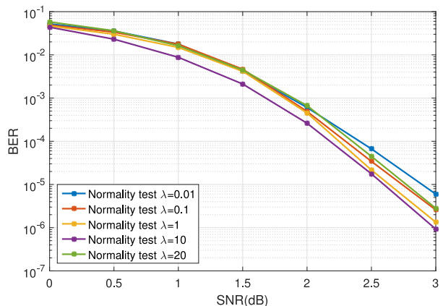


BP-CNN – Simulation
GiGi, Chou
TNT_LAB , NYCU
16
January , 2

Slide 17
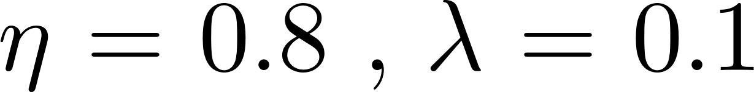
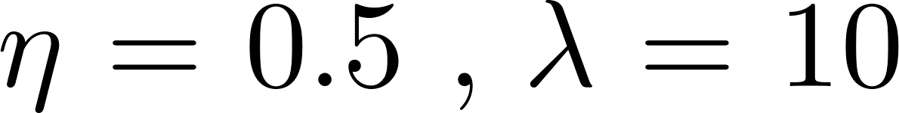
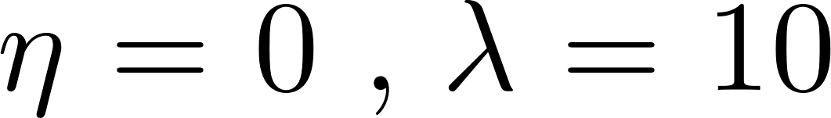
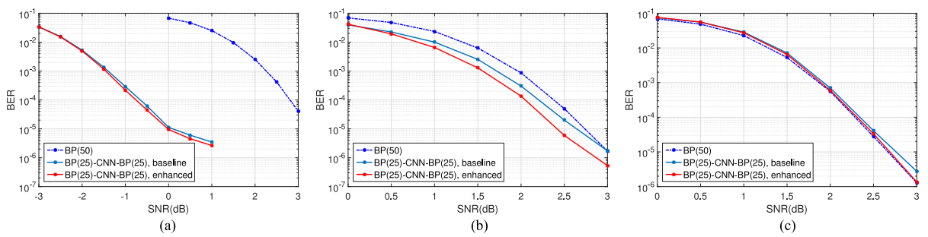
BP-CNN – Simulation
GiGi, Chou
TNT_LAB , NYCU
17
January , 2

Slide 18
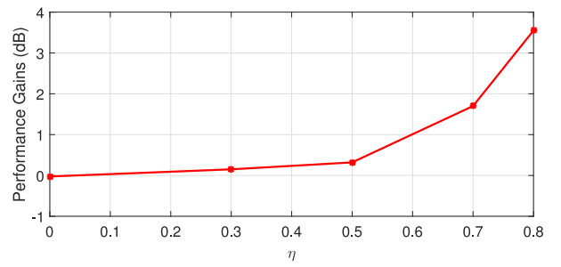
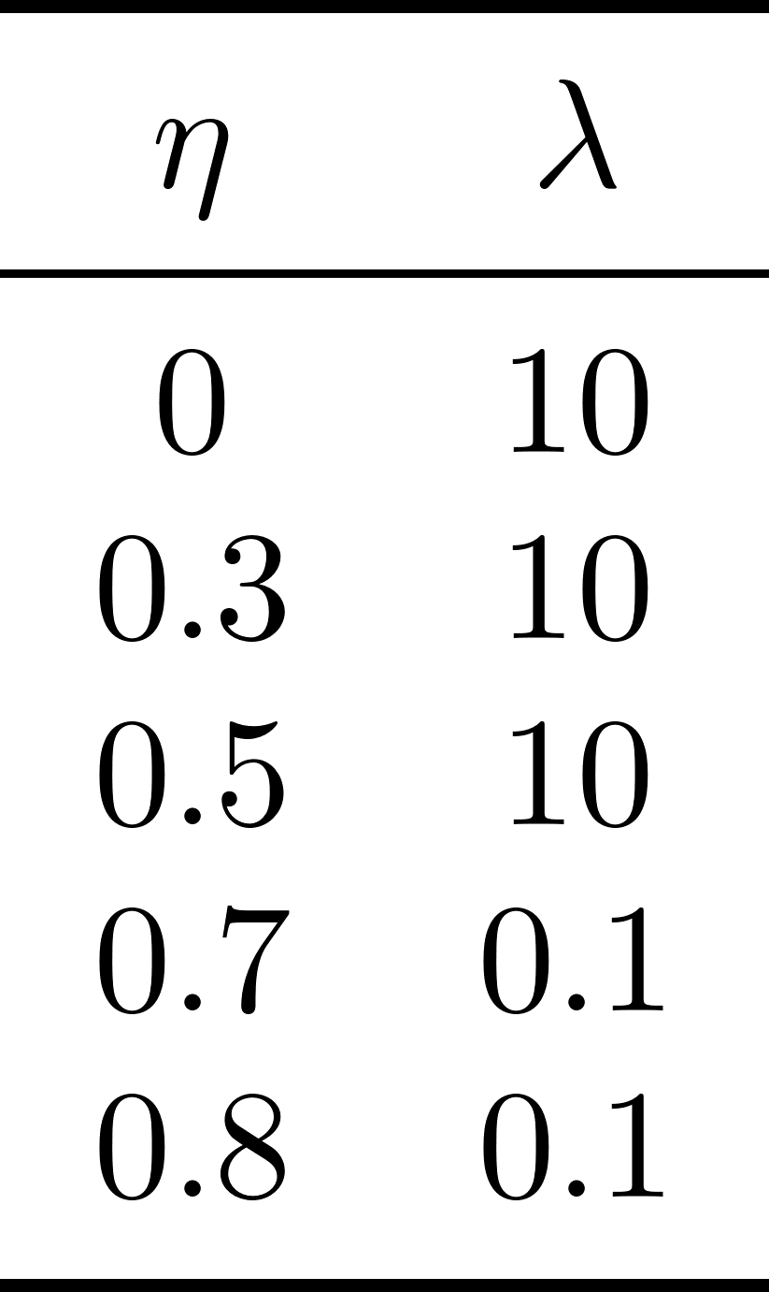

BP-CNN – Simulation
GiGi, Chou
TNT_LAB , NYCU
18
January , 2

Slide 19

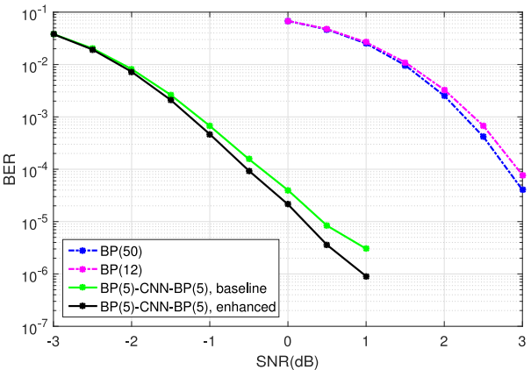
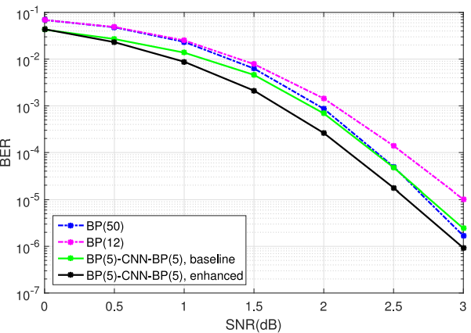
BP-CNN – Simulation
GiGi, Chou
TNT_LAB , NYCU
19
January , 2

Slide 20

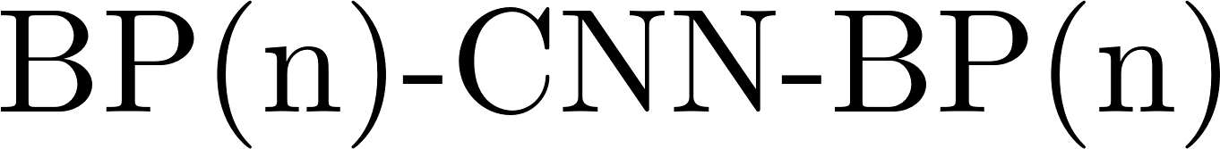
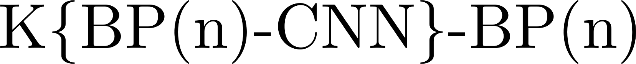

BP-CNN – Simulation
BP
CNN
BP
BP
CNN
BP
GiGi, Chou
TNT_LAB , NYCU
20
January , 2

Slide 21
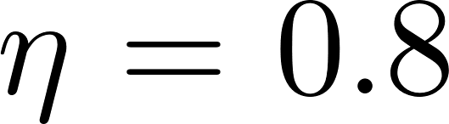
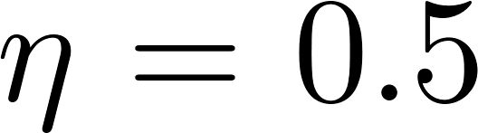
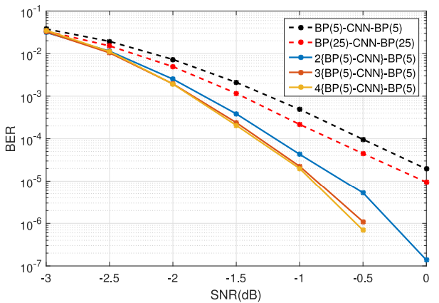
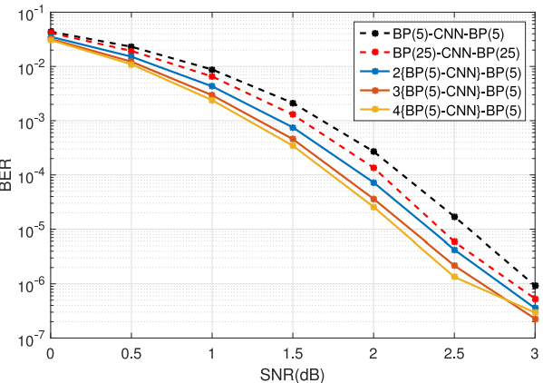
BP-CNN – Simulation
GiGi, Chou
TNT_LAB , NYCU
21
January , 2

Slide 22

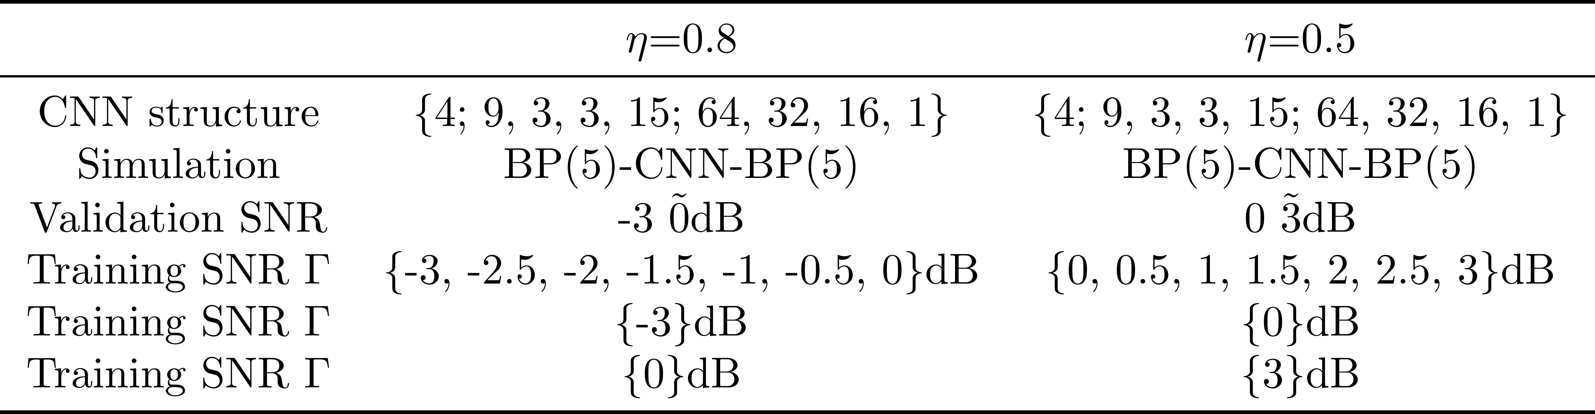
BP-CNN – Simulation
GiGi, Chou
TNT_LAB , NYCU
22
January , 2

Slide 23
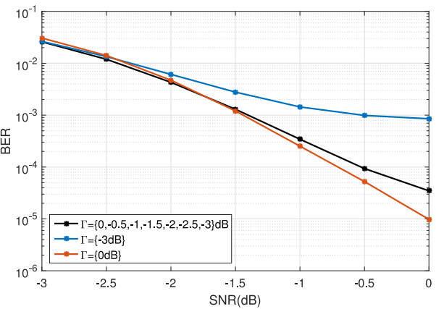
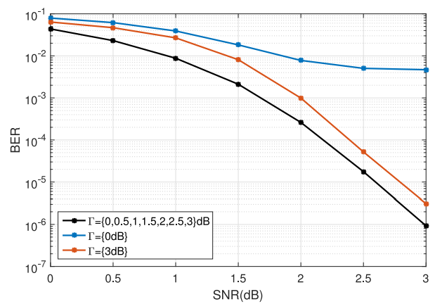
BP-CNN – Simulation
GiGi, Chou
TNT_LAB , NYCU
23
January , 2

Slide 24


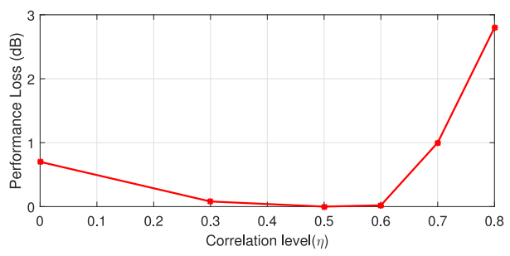
BP-CNN – Simulation
GiGi, Chou
TNT_LAB , NYCU
24
January , 2
Notes:
雖然loss，但是還是會比傳統的bp還要好
. The mismatched BP-CNN architecture still outperforms the standard BP when η is large.

Slide 25
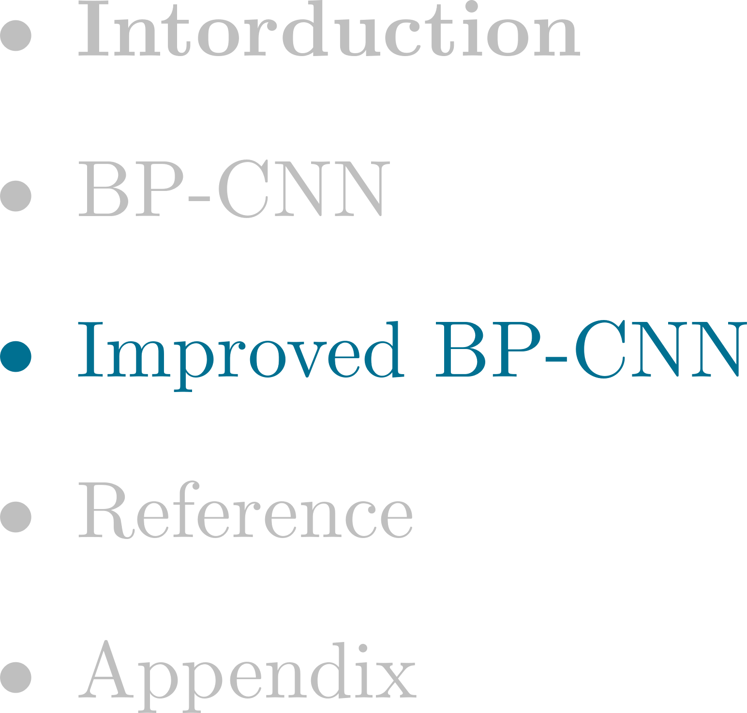
Outline
GiGi, Chou
TNT_LAB , NYCU
25
January , 2

Slide 26

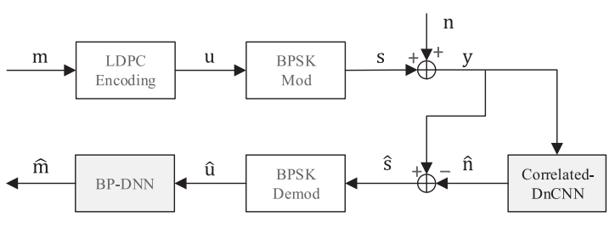

Improved BP-CNN
GiGi, Chou
TNT_LAB , NYCU
26
January , 2
Notes:
雖然loss，但是還是會比傳統的bp還要好
. The mismatched BP-CNN architecture still outperforms the standard BP when η is large.

Slide 27
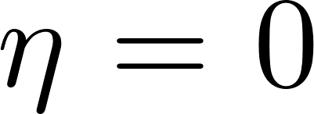

Improved BP-CNN
GiGi, Chou
TNT_LAB , NYCU
27
January , 2
Notes:
雖然loss，但是還是會比傳統的bp還要好
. The mismatched BP-CNN architecture still outperforms the standard BP when η is large.

Slide 28

Outline
GiGi, Chou
TNT_LAB , NYCU
28
January , 2

Slide 29

Reference
GiGi, Chou
TNT_LAB , NYCU
29
January , 2
Notes:
把Y检测到的码字的影响給消除掉。

Slide 30

Outline
GiGi, Chou
TNT_LAB , NYCU
30
January , 2

Slide 31






















Appendix - Belief Propagation Algorithm
GiGi, Chou
TNT_LAB , NYCU
31
January , 2

Slide 32

















Appendix - Belief Propagation Algorithm
GiGi, Chou
TNT_LAB , NYCU
32
January , 2

Slide 33



Appendix - Belief Propagation Algorithm
GiGi, Chou
TNT_LAB , NYCU
33
January , 2

Slide 34



Appendix - Belief Propagation Algorithm
GiGi, Chou
TNT_LAB , NYCU
34
January , 2

Slide 35

Appendix - Belief Propagation Algorithm
GiGi, Chou
TNT_LAB , NYCU
35
January , 2

Slide 36
Thanks

